Slide 1
Lecture 12: Life Skills 2 & 3: DEBUGGING & Documentation
CSC111: Introduction to CS through Programming
R. Jordan Crouser
Assistant Professor of Computer Science
Smith College

Slide 2
Announcements
A2 feedback posted to Moodle
A note about bonus points:
The max score for any homework assignment is 10 / 10
If you earn more than 10 points on a given assignment, the other points are ”banked”
These will be applied to your HW total (up to a max of 100%) at the end of the semester

Slide 3
Overview
Monday: Loops
for…in (looping through items in a list)
the range() function (getting a list of numbers)
while (looping until something happens)
Lab: Loops
Wednesday: Life Skill #2/3: Debugging & Documentation
Friday: Dictionaries and Sets

Slide 4
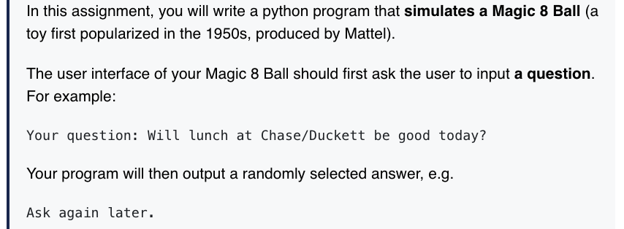

Assignment 3 (what’s hard so far?)

Slide 5
Discussion
What is your plan
for getting unstuck?

Slide 6
RECAP: the programming process

Slide 7
Fun history: the term “debug”
RDML Grace M. Hopper
b.1906 – d.1992
Notes:
The term "bug", in the sense of "technical error", dates back at least to 1878 when it appeared in a private letter written by Thomas Edison. However, the terms "bug" and "debugging" with respect to computation are popularly attributed to Admiral Grace Hopper, the same person for whom the Annual Grace Hopper Celebration of Women in Computing is named. In 1946, when Admiral Hopper was released from active duty, she joined the Harvard Faculty at the Computation Laboratory where she continued her work on the Mark II and Mark III. Operators traced an error in the Mark II to a moth trapped in a relay. This bug was carefully removed and taped to the log book along with the notation "First actual case of bug being found.” This log book, complete with attached moth, is part of the collection of the Smithsonian National Museum of American History.^{[11]}

Slide 8
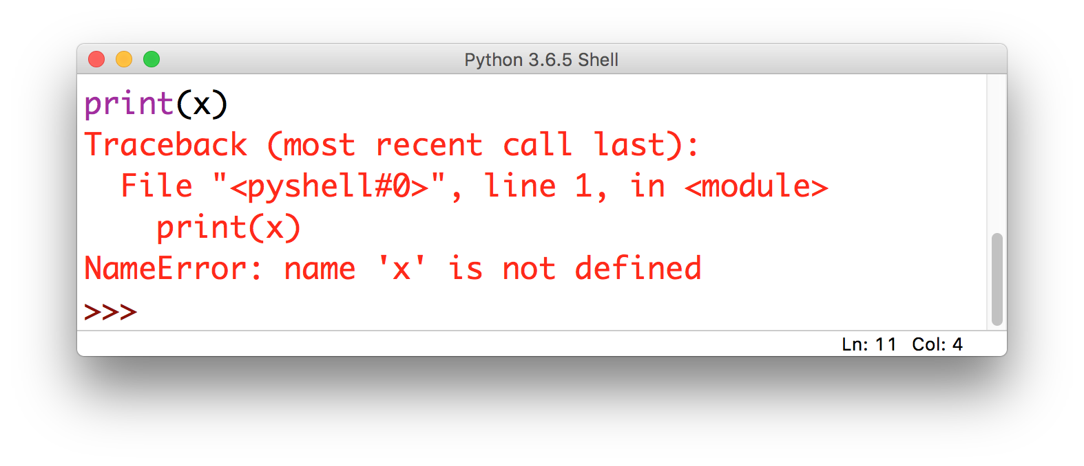
Some problems are obvious
this is called
an Exception

Slide 9
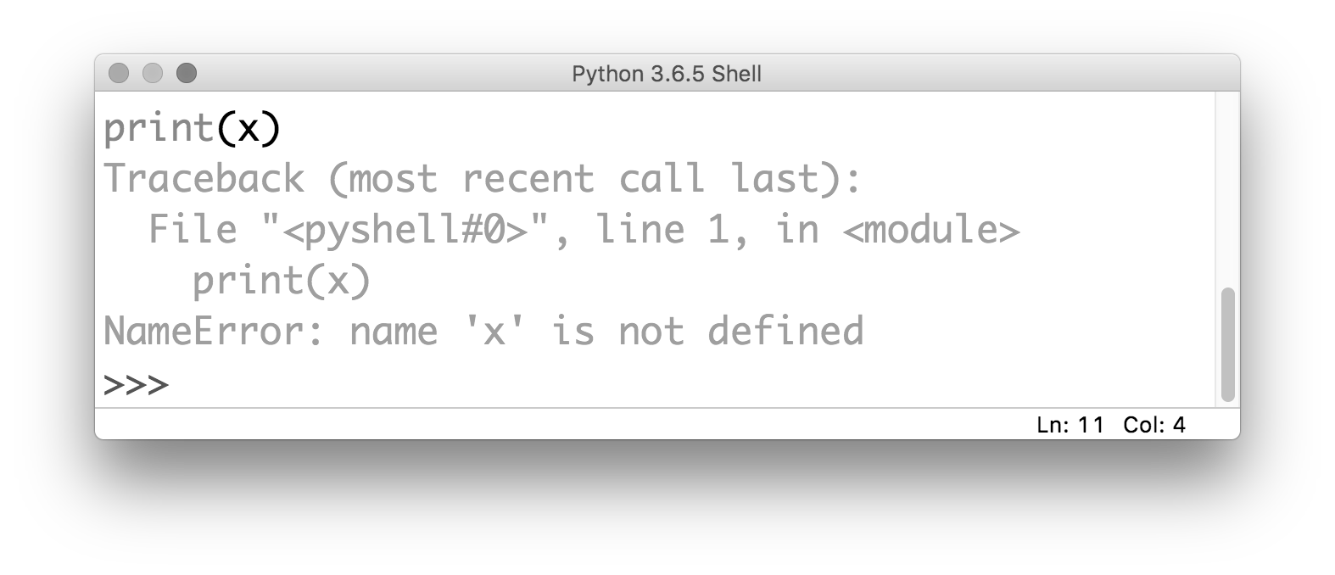
Some problems are obvious
the kind of error gives you
a clue about what the problem is

Slide 10
Some problems are obvious
it also tells you where the problem is
(but be careful!)

Slide 11
Common Exceptions
NameError: raised when Python can’t find the thing you’re referring to (a variable or a function)

Slide 12
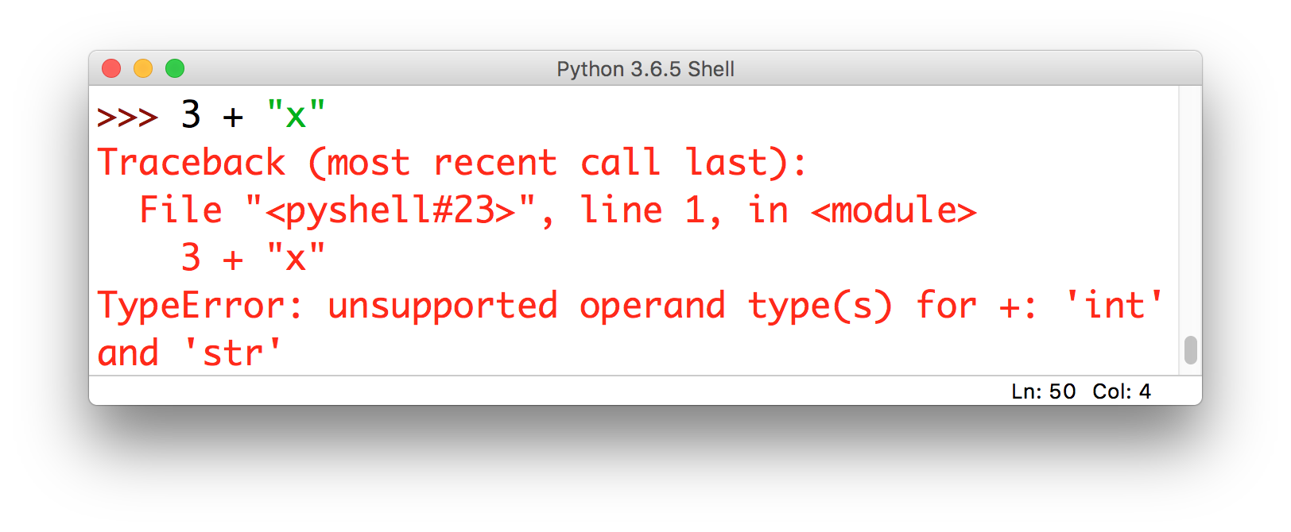
Common Exceptions
TypeError: raised when you try to perform an operation on an object that’s not the right type (i.e. a string instead of a number)

Slide 13
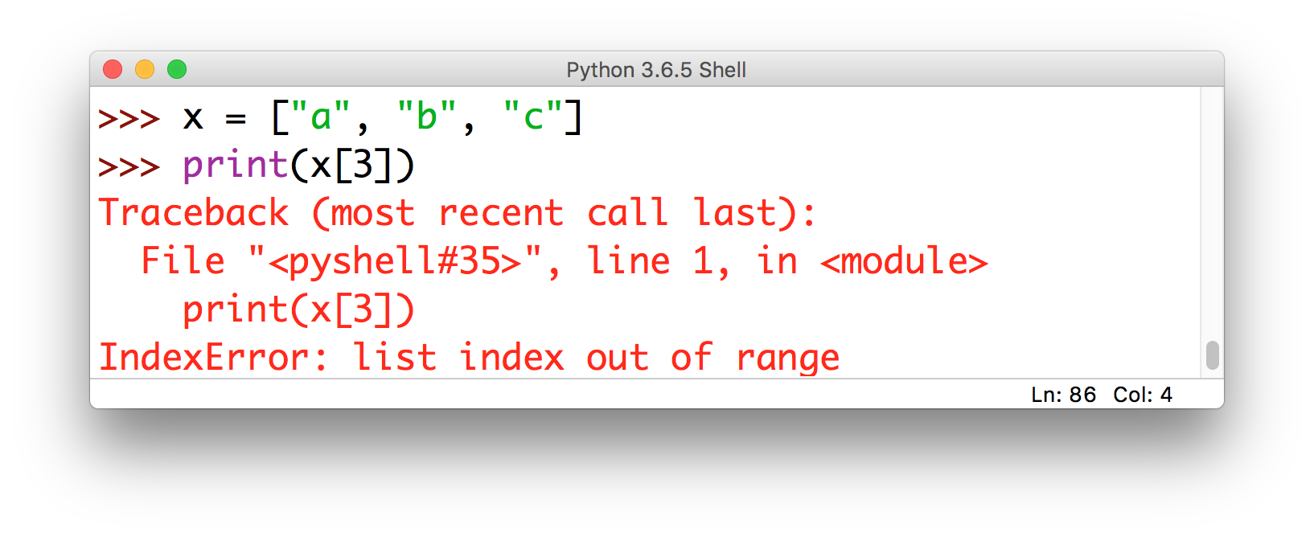
Common Exceptions
IndexError: raised when you try to use an index that’s out of bounds

Slide 14
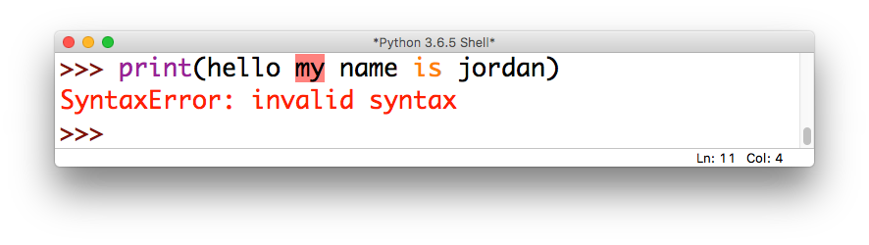
Common Exceptions
SyntaxError: raised when you try to run a command that isn’t a valid Python statement

Slide 15
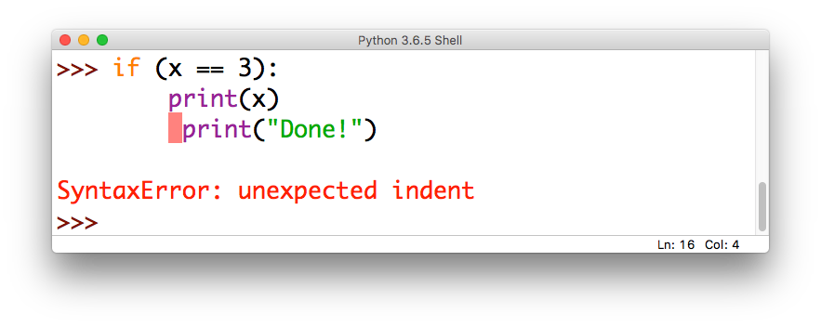
Common Exceptions
SyntaxError: also raised if your indentation is messed up (this is a special kind of SyntaxError called an IndentationError)

Slide 16
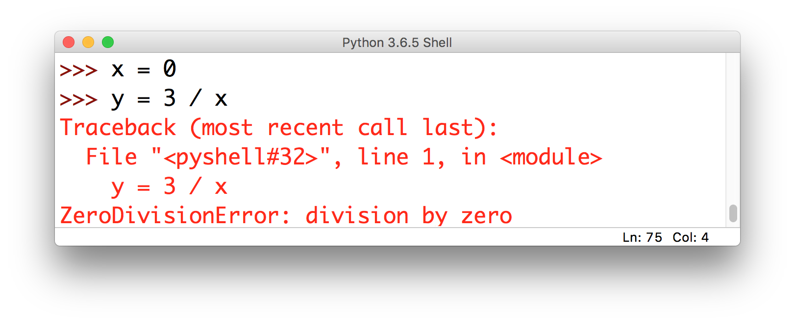
Common Exceptions
ZeroDivisionError: raised when you try to divide by zero (or do modular arithmetic with zero)

Slide 17
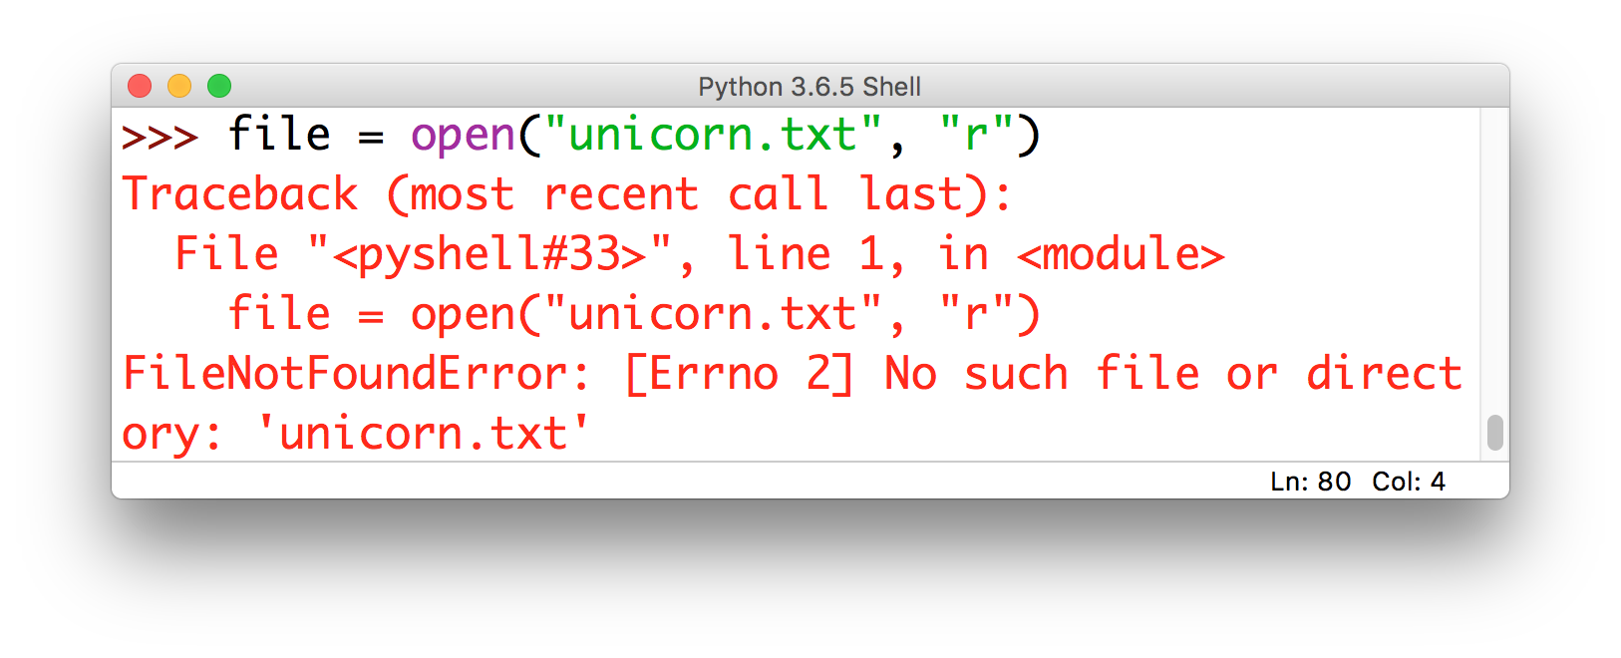
Common Exceptions
FileNotFoundError: raised when Python can’t find the thing you’re referring to (a file)

Slide 18
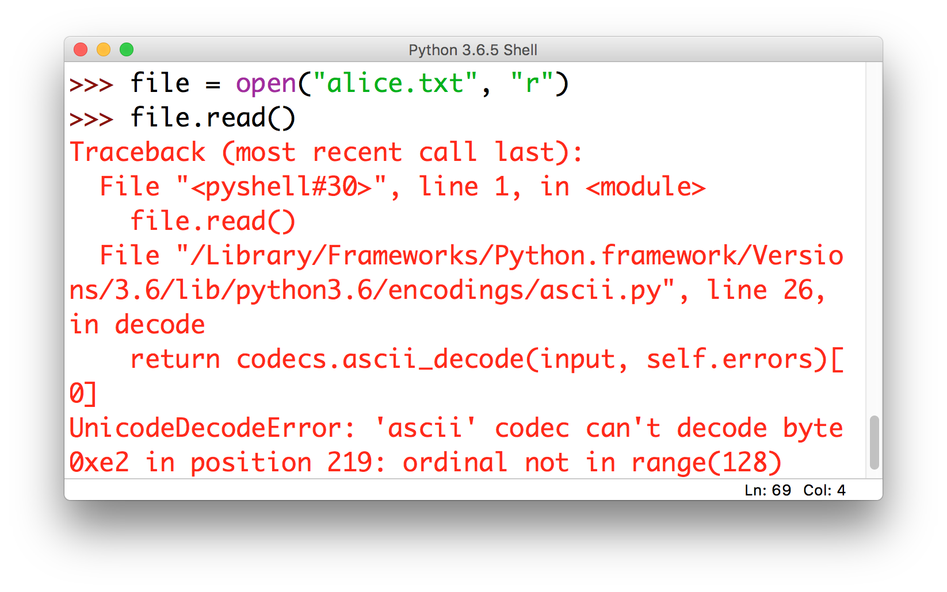
Common Exceptions
UnicodeDecodeError: raised when you try to read a file that has weird characters in it (most common culprit: apostrophe vs. the single quote)

Slide 19
Less common Exceptions
Did your program throw an Exception not listed here?
Look it up at:
https://docs.python.org/3/library/exceptions.html

Slide 20
Exceptions = relatively easy to fix
Why would I say that?
What’s the alternative?

Slide 21
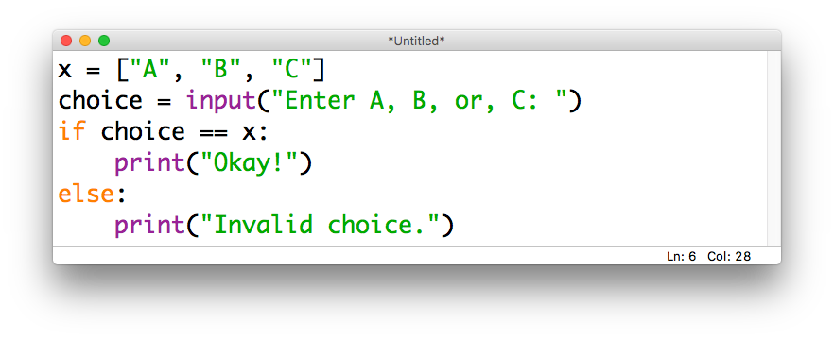
Logical errors
Mistakes in the reasoning behind the code (though the statements are valid and there are no Exceptions), e.g.
perfectly valid
(just not what we wanted)

Slide 22
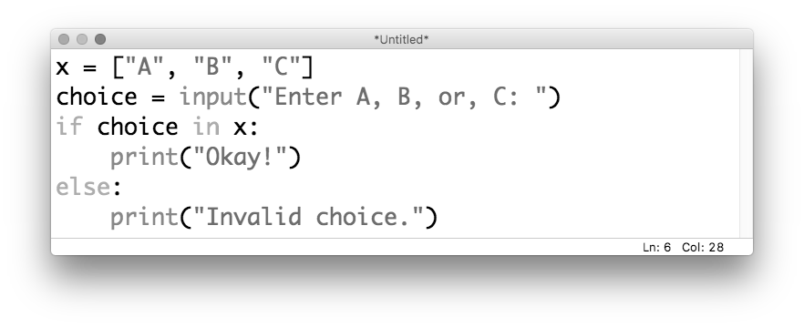
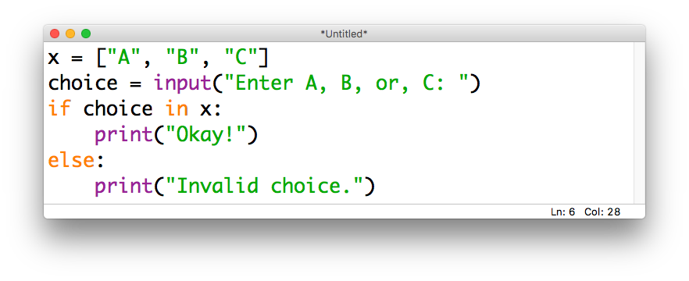
Logical errors
Mistakes in the reasoning behind the code (though the statements are valid and there are no Exceptions), e.g.
what we were
actually going for

Slide 23
An analogy
Syntactic Error
Their is no
reason to be concerned.
Logical Error
If an animal is green, it must
be a frog.

Slide 24
Discussion
How do you find and fix logical errors?

Slide 25
Step 1: map out the code
It is impossible to debug code that you don’t understand (and it’s possible to not understand code even if you wrote it!)
It’s often helpful to map out how the code fits together:
main()
printGoodbye()
printHello()

Slide 26
Step 2: “rubber ducking”
Still stuck? Try explaining it to someone else (or historically, to a rubber duckie)
This is the debugging equivalent of pair programming
“Okay, so first we
are going to round() the user’s input and then
...oh wait…
I think maybe the problem is that I forgot to eval() the input first, so it’s
still a string!

Slide 27
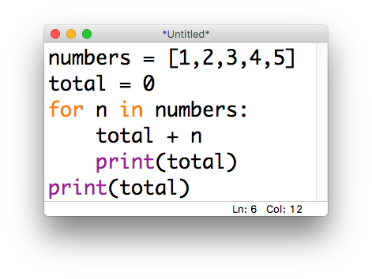
Step 3: add print() statements
Not sure exactly where things are going wrong (esp. inside a loop)?
Add print() statements to leave a “trail” on the console

Slide 28
In the beginning…

Slide 29
Now…

Slide 30
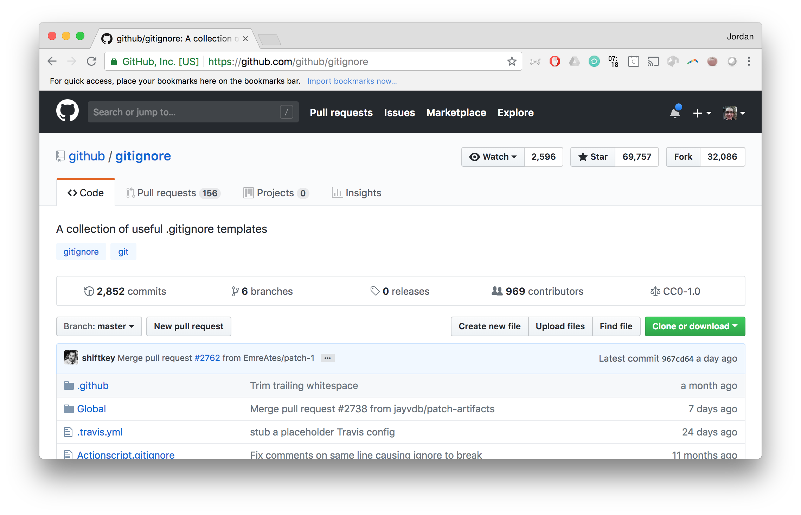
Eventually…

Slide 31
The point
Other people need to be able to understand your code
Future you needs to be able to understand your code
Document it
… but how?

Slide 32
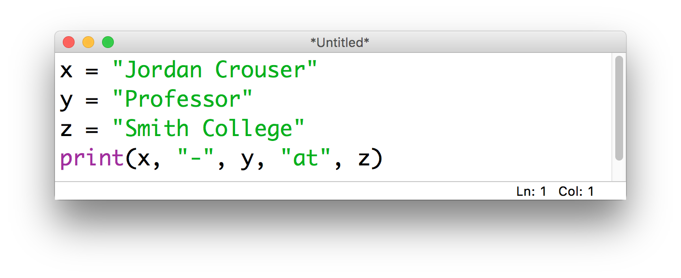
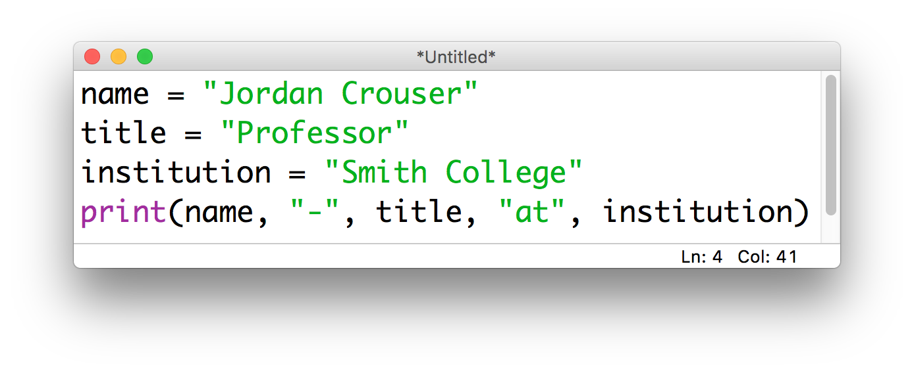
Step 4: meaningful nouns for variables

Slide 33
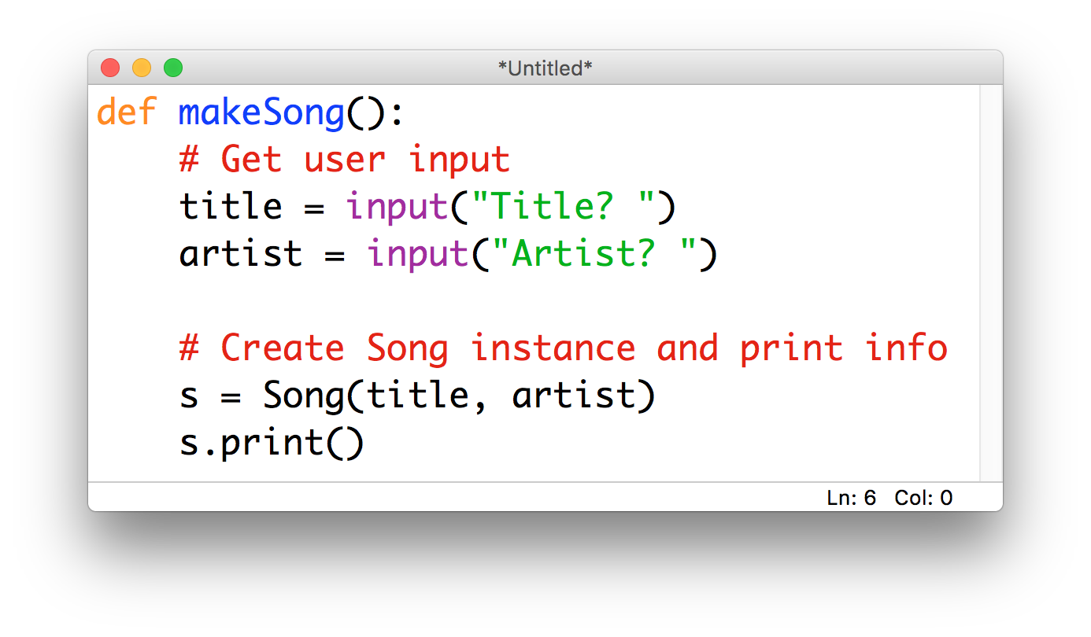
Step 5: lots of comments

Slide 34
A useful technique: code tracing
Given: a very short, poorly-documented program
Your goal: try to figure out what it’s doing
Recommendations:
walk through the program step-by-step (“trace its execution”) using the whiteboard or paper instead of typing it into a repl
once you understand what’s happening, then rewrite it using informative variable names and comments

Slide 35
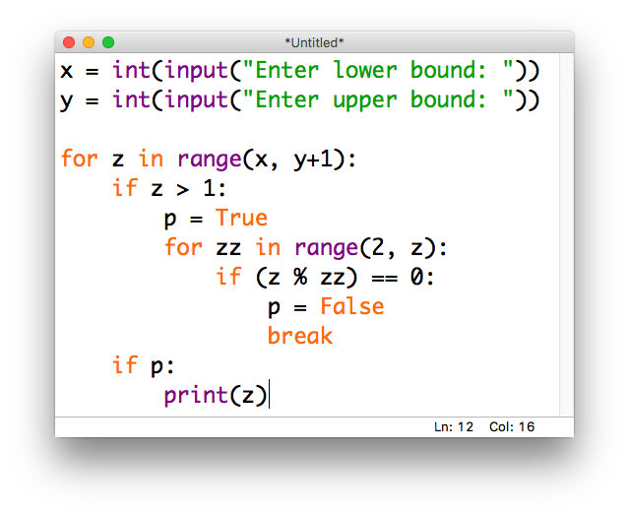
Example

Slide 36
Takeaways
This is a crash course in basic debugging / documentation
There are lots of other techniques for both dealing with and preventing bugs, but for now this will suffice
The most important part is to understand:
what the code is trying to do
what the code is actually doing
Tips:
change one thing at a time
keep track of what you change!

Slide 37
Demo
Notes:
https://repl.it/@JordanCrouser/connectFour

Slide 38
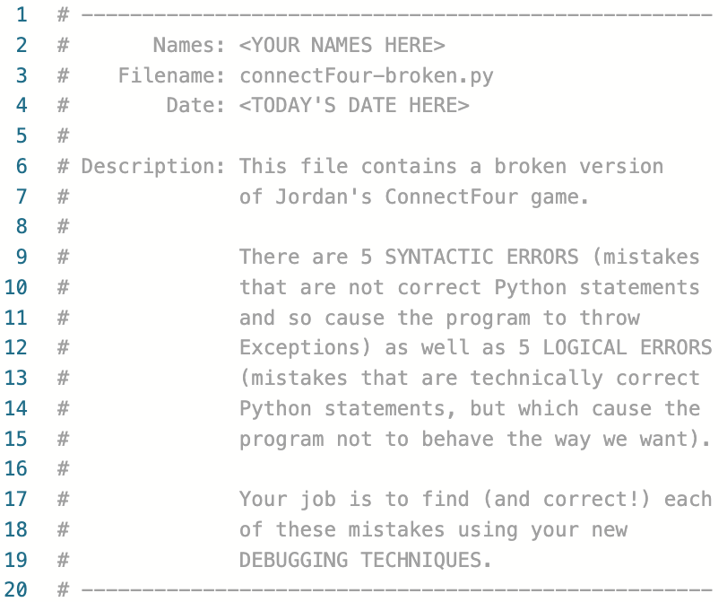
Your task
Notes:
https://repl.it/@JordanCrouser/connectFour-broken

Slide 39
Discussion
What did you find?

Slide 40
Up next
Monday: Loops
for…in (looping through items in a list)
the range() function (getting a list of numbers)
while (looping until something happens)
Lab: Loops
Wednesday: Life Skill #2/3: Debugging & Documentation
A3: Magic 8 Ball due Thursday at 11:55pm EST
Friday: Dictionaries and Sets

